Slide 1

Data Modernization w/ Metadata
Charles @ The II Lakes Group
Notes:
Metadata isn't a new concept. It's actually been around for a long, long time, but many companies still haven't put it into practice. Why migrate to the cloud and not use metadata? You shouldn’t.
Documents are typically stale, once published, but information around them can change. Like the last time something was reviewed, which department someone is a part of, updating the tags to an image, etc. The video and image files don’t change, but their properties can. State-machine workflows to approve expense reports.
Business intelligence tools like Power BI. Workflow automation like Power Automate.
With rise of AI, metadata can be built to determine AI processes and executions.
“under-structured”

Slide 2



Sponsors
Gold
Special Thanks
Gold

Slide 3

Agenda
Who
What
Why
When
Where
Notes:
Will switch these around a bit and tackle them in a different order…

Slide 4

What:
“… a set of data that describes and gives information about other data.”
Notes:
Meant to surface the most important data.
Sometimes going by other names:
E.g., Properties; Tags; Labels; Stickers; Flags; Stamps; Notes;
Everyone is using metadata to some capacity.
Example:
Searching for a book in Barnes & Noble.
Doing a Google search with date or author filters.
Shopping for a car and comparing dimensions, fuel mileage, and features like heated seats, sunroof, wheel locks, etc.

Slide 5
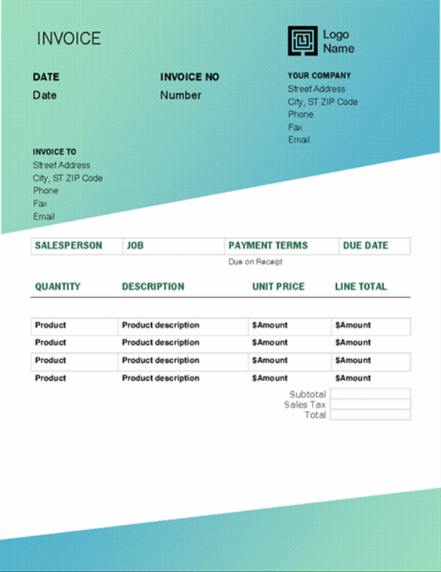

Example
Key-value pairs
Name: 2022 Audit Tool
Invoice No.: 1923829
Invoice Date: 12/31/2022
Department: Compliance
Approver Name: Charles Lakes
Status: Sent
Notes:
What is the important data of an invoice?
Other possible metadata types:
E.g., Created By; Created Date; Modified By; Modified Date; Version number; Property Address; Invoice Amount; Publish Date; Is Archived; Contract Expiration Date;

Slide 6

Why:
Data is currency.
Data is power.
Data is king.
Notes:
Data is king. Who has the most data? Who has the most organized data? Data is for sell…
Metadata adds depth to data. Essentially like a database of properties. More impactful and helpful w/ documents and images. Like, where was this taken, when, elevation, etc.
Better organization. Improved search. Improved content filtering…
Business intelligence; efficient process automations;

Slide 7
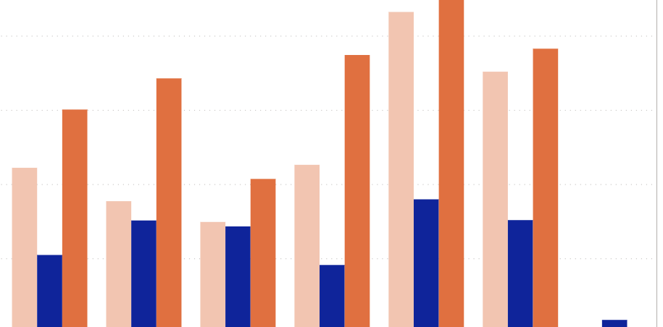
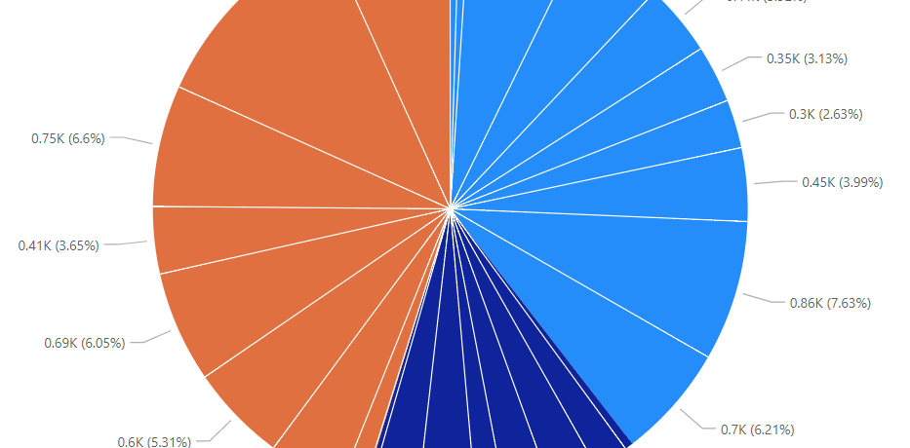

Example
Key Performance Indicators
Name: 2022 Audit Log
Reviewed Date: 12/31/2022
Department: Compliance
Reviewer Name: Charles Lakes
Status: Published
Notes:
Other possible metadata types:
Business Intelligence. Have you heard of Power BI?
Companies are trying to learn more and more from their data, but not everyone is a data scientist. Business leaders need dashboards w/ KPIs so they can make important decisions. Are we good? Are we bad? Where do we need to focus our attention? Are we behind on anything?
AI also uses properties to understand context.
In addition to insights, businesses can create automations. Run this process is a value falls below a specific threshold. Escalate to these people if a count exceeds an allowable amount?

Slide 8

Who:
Social media
Streaming platforms
eCommerce shopping
Banks
Notes:
Prominent examples of usage:
Big tech companies and big banks, which are becoming tech company-like, use and consume metadata to measure, project, and scope things.
Social media: TikTok, Instagram, Facebook, and the like use hashtags.
Streaming giants like Netflix, Disney+, Amazon Prime, Apple TV store things like title, producer, actors, genres as metadata, which are then searchable and filterable.
eCommerce shopping like Target, Walmart, Zappos, and anyone with notable online presence. They use their metadata for business intelligence.
Brick and motor banks like Bank of America and online banks like Ally.
When travelling, you might use Yelp: Where are the restaurants w/ a patio? Who has vegetarian options?
When organizing an event, you might use Google: Where are the event spaces w/ a ballroom?

Slide 9

When:
ASAP!
Expeditiously!
Forthright!
Notes:
You are limited with the business insights that can be gathered without metadata.

Slide 10

Where:
SharePoint Online/ Server
Microsoft Dynamics 365
Salesforce
Etc.
Notes:
Where?!
There are plenty of system leveraging metadata in technology
BONUS!!! How?!
Analyze folder paths: Deeply nested paths give insight into what kind of properties are needed.
Analyze file types: Are departments Excel heavy or PDF heavy? Are there tons of Word documents? These could be contracts or invoices, so create content types of common fields.
Analyze work processes: Are processes dependent on moving files between folders? Instead, change metadata fields like status columns to trigger automations…

Slide 11

Contact:
CharlesLakes.com
github.com/losodamus

